Slide 1

Engaging with Stakeholders
Marisa Mason
NCEPOD

Slide 2
Who are our stakeholders?
Patients
Public/lay
Clinicians
Audit staff
Hospital managers
National leads
Government depts.
Regulators
Commissioners
Third sector
Independent sector

Slide 3
At the start of a study
Anyone can suggest an idea
The end product therefore meets a need
Process ensures that it is not a lone concern
Colleges
Specialty associations
Lay representation
Funding bodies
Meeting with the study proposer
Identify other work in the area and speak to them

Slide 4
During the study
Study advisory groups - identify the concerns
Multidisciplinary – clinical and patient/lay
Nominated members
Study proposers
Case reviewers
Multidisciplinary – clinical

Slide 5



During the study
Local Reporters and Ambassadors
Organisational questionnaire – medical directors
Clinical questionnaires – those involved in care
Patient/parent/carer questionnaire

Slide 6
During the study
Meet people at topic specific conferences
Stands at meetings
Arrange to meet people to talk about the work
Newsletters
Flyers
Social media
Talks

Slide 7
Towards the end of the study
Results are reviewed by the
Study Advisory Group
Case reviewers
Lay group
NCEPOD Steering Group – Colleges/Associations
HQIP’s Independent Advisory Group
Recommendations - consensus exercise
Linked to existing ones if possible – start to bring in other organisations

Slide 8
Prior to publication
See what other work is going on
Start notifying organisations that may be responsible for acting on a recommendation
Have meetings to informally discuss the findings
Send copies under embargo a month ahead
Remind people why the study was undertaken

Slide 9
At publication
Invite responses to the report
Invite high profile people to speak at the report launch
Disseminate the report as far as possible
Create a buzz on social media
Work with press contacts for coverage on the day and as follow-up pieces

Slide 10
Post publication
Report and additional materials widely available
Presentations
Patient leaflets
Summaries and infographics
Local presentations
Impact assessment – demonstrates the worth
Promotion of local work

Slide 11
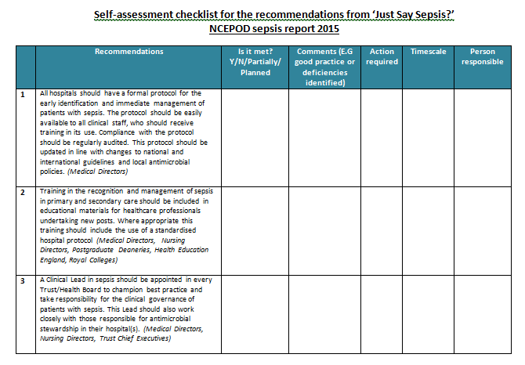
Post publication

Slide 12

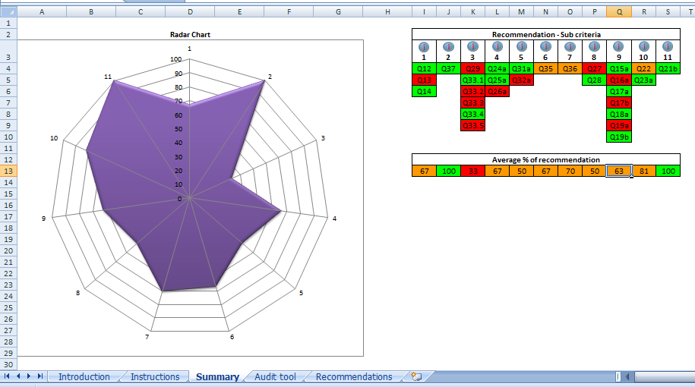
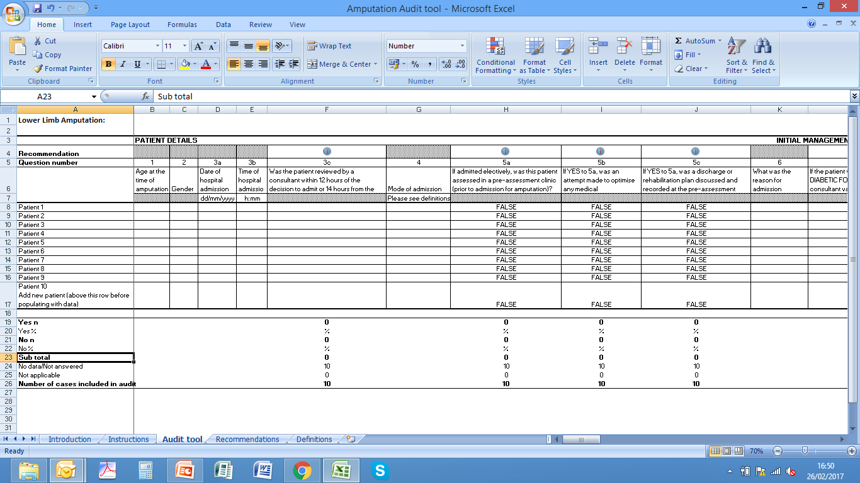
Audit tools

Slide 13
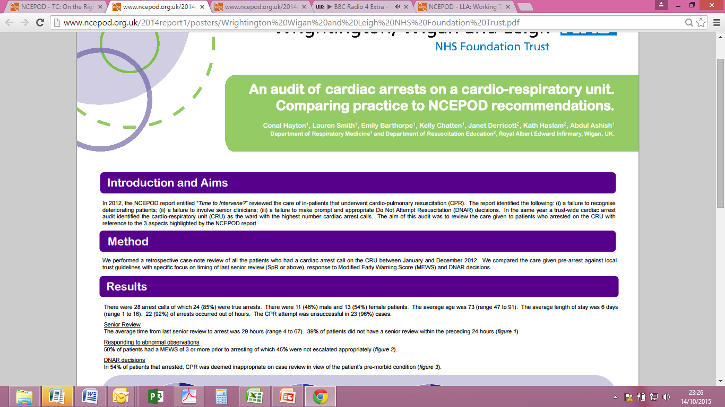
Posters

Slide 14










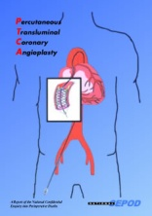


























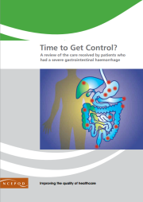


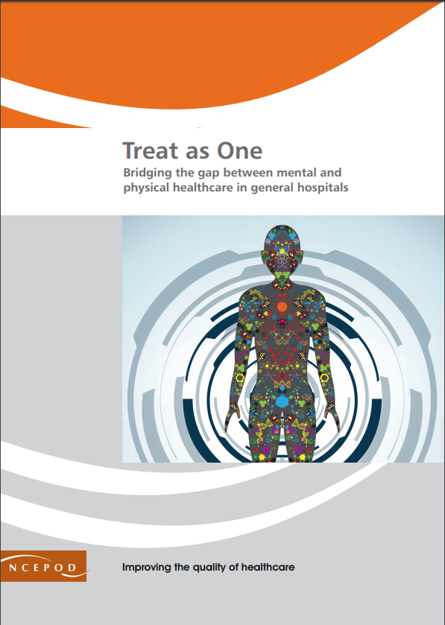
Reports

Slide 15
Tracheostomy
Suggested by AAGBI and ICS
ICS guidelines were updated on the same day
as our report came out
Brendan McGrath appointed as National Tracheostomy Lead
The Improving multidisciplinary tracheostomy care: implementing the Global Tracheostomy Collaborative quality improvement project offers solutions to many of the challenges outlined in the NCEPOD report.

Slide 16
Sepsis
Suggested by UK Sepsis Trust
Met with them and patients
APPG for sepsis – met to see their report
NHSE – waited for both reports
NICE guidelines – all work fed into this
BBC got early sight for ‘Trust Me, I’m a Doctor’
Local change supported thorough newsletter/posters

Slide 17

Non-invasive ventilation
Suggested by British Thoracic Society
Working with them so that they can develop Quality Standards
Linking with speakers for the launch
Liaising with RCP and NHSE to promote work they have done

Slide 18
Summary
The comms plan starts on day 1
Talk to everyone and anyone
Find enthusiasts – and ask for help
Face to face is always better – so get out and about
The aim is to improve patient care, not to catch anyone out - share wherever possible
It’s not hard, but it is time consuming
Notes:
The communications plan starts on day 1 – not at the point of publication
Talk to everyone and anyone - focus on key people who can help you drive change and find enthusiasts
Face to face is always better – so get out and about
The aim is to improve patient care not to catch anyone out so share wherever possible
It’s not hard, but it is time consuming
From start to finish - assume no one knows about the project

Slide 19


Top tip

Slide 20

Thank you
www.ncepod.org.uk
@ncepod

